Slide 1
Forms, PHP, and Form Processing

Slide 2
Form Processing
Web Server
Form
Response
Query
CGI
Program
Web Browser
The server side program to process incoming HTTP requests should conforms to the Common Gateway Interface (CGI).
PHP is a popular language for implementing CGI programs.

Slide 3
A Simple Form
<form method="post" action="welcome.php">
<pre>
<label for="n">Full Name:</label>
<input id="n" name="client_name" size="25" />
<label for="e">Email:</label>
<input id="e" type="email" name="client_email" size="25" />
<input type="submit" value="Send" />
</pre>
</form>
Demo: Ex: SimpleForm

Slide 4
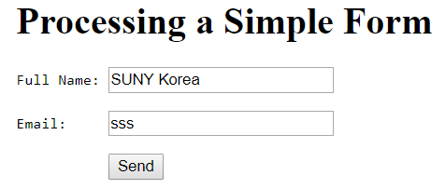
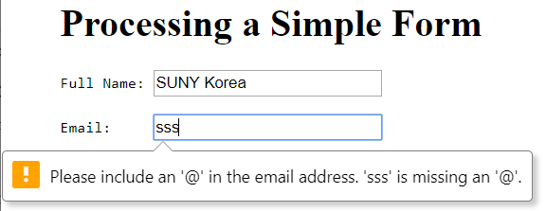
A Simple Form

Slide 5
Basic Input Elements
A typical form element consists of these essential parts:
Instructions for the user on what information is sought and how to fill out the form.
Blank fields, produced by input collection elements, to be completed by the user.
Text or label for each input control to clearly indicate the exact information to be entered.
A button or a submit type input element, for the user to click and submit the completed form.
An HTTP query method, given by the method attribute of form, for sending the formdata to the server. It is advisable always to use the post method even though get is the default.
A URL, given by the required action attribute, for a server-side program to receive and process the collected formdata of the form element.

Slide 6
General Form of form
<form method="post or get" action="program-URL">
flow elements each may
contain input-control elements
</form>

Slide 7
Text Input
<input name="lastname" type="text" size="15" maxlength="25" />
User input becomes the value of the input control. The received input is submitted as a key-value pair—for example,
lastname=Katila

Slide 8
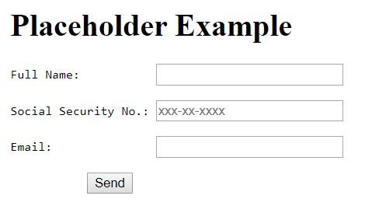
Text Field with Placeholder
<label for="so">Social Security No.:</label>
<input id="so" name="ss" placeholder="xxx-xx-xxxx" required="true" />
Demo: Ex: Placeholder

Slide 9
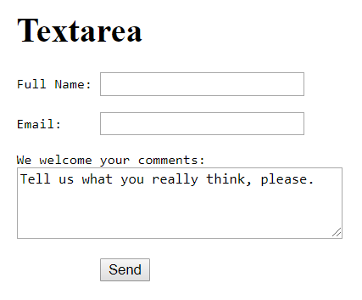
textarea
<label for="c">We welcome your comments:</label><br/>
<textarea id="c" name="feedback" rows="4" cols="40"> Tell us what you really think, please.</textarea>
Demo: Ex: TextArea

Slide 10
Input in Standard Formats
date—The input string must follow the date and time format specified by the Internet standard (RFC 3339) explained in.
month–In the form of yyyy-mm.
week—In the form of yyyy-Www where ww is between 01 and 53.

Slide 11
Additional Input Formats
email—An email address in the correct format.
url—An absolute URL or empty string, on one line.
number—A positive or negative integer or floating-point number.
range—A number within a given min="number" and
max="number" range with a specific step.
search—A plaintext string for searching, on one line.
tel—A telephone number, on one line.
color—A hex color name #rrggbb; color names or abbreviations are not allowed.

Slide 12
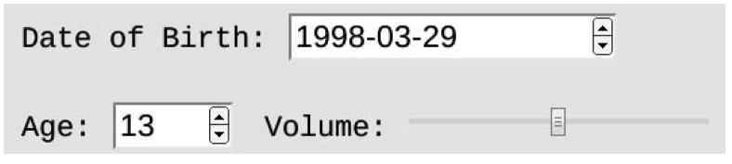
Sample Input Fields
<input type="date" name="birth" size="15" />
<input type="number" name="age" size="4"
min="0" max="200" maxlength="4" />
<input type="range" name="volume" min="0"
max="1" step="0.01" />

Slide 13
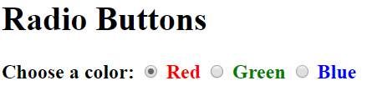
User Choices and Selections
Radio Buttons
<p style="font-size: larger; font-weight: bold;"> Choose a color:
<input id="r" type="radio" name="color"
value="red" checked="" />
<label for="r" style="color: red">Red</label>
<input id="g" type="radio" name="color" value="green" />
<label for="g" style="color: green">Green</label>
<input id="b" type="radio" name="color" value="blue" />
<label for="b" style="color: blue">Blue</label></p>
Demo: Ex: RadioButton

Slide 14
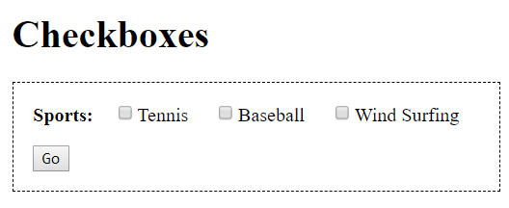
Checkboxes
<p style="font-size: larger; font-weight: bold;"> Sports: <input id="t" type="checkbox" name="tennis" />
<label for="t">Tennis</label>
<input id="b" type="checkbox" name="baseball" />
<label for="b">Baseball</label>
<input id="w" type="checkbox" name="windsurf" />
<label for="w">Wind Surfing</label></p>
Demo: Ex: CheckBoxes

Slide 15
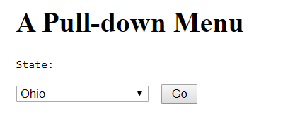
Pull-Down Menus
<label for="st">State:</label
<select id="st" name="state" size="1">
<option value="0"> Pick One </option>
<option value="Alabama"> Alabama </option>
<option value="Alaska"> Alaska </option>
...
</select>
Demo: Ex: PullDown

Slide 16
Menu Option Grouping
<form method="post" action="showdata.php">
<select id="menu" name="menu[]" size="8" multiple="multiple">
<optgroup label="Soup">
<option value="hot and sour">Hot and Sour Soup</option>
<option value="egg drop">Egg Drop Soup</option>
<option value="chicken noodle">Chicken Noodle Soup
</option> </optgroup>
<optgroup label="Salad">
<option value="garden">Garden Salad</option>
<option value="spinach">Spinach Salad</option>
<option value="fruit">Fruit Salad</option>
</optgroup></select></p></form>
Demo: Ex: OptGroup

Slide 17
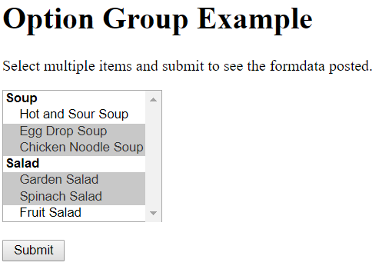
Menu Option Grouping

Slide 18
Form Submission
A user clicks on a submit button to trigger a sequence of browser actions to submit the completed form.
First, necessary validations are performed to make sure required entries have values and values have the correct formats. The user must fix any problems found and submit again.
Upon successful validation, the entire set of input, known as the formdata, is then encoded and sent to the designated server-side program using the desired HTTP method.
The form attribute method indicates the HTTP method post or get, action specifies the server-side program, and enctype sets the way data are encoded.

Slide 19
Form enctype
Possible enctypes are
application/x-www-form-urlencoded—Under this default encoding, the formdata is sent, under either the post or get method, as a query string consisting of name=value pairs separated by the & character with each name and value URL encoded.
multipart/form-data—Used together with the HTTP post
method when the form contains file uploading.
text/plain—Working under the post method, the name=value pairs are sent, verbatim without encoding, in a string separated by space characters. This enctype is often useful for sending computer codes.

Slide 20
submit Buttons
The basic submit button for a form is
<input type="submit" value="button-label" />
Please use a meaningful button-label that relates to the purpose of the form. A form may have multiple Submit buttons with different values.
You may customize the look of a Submit button by using an
image input element
<input type="image" src="url" name="key" alt="..." />
Data sent to the server-side program are in the form
key.x=x0 key.y=y0
Alternatively
<button name="submit" value="join">Join the Club
</button>
Demo: Ex: ImageInput

Slide 21
File Uploading
Use the the file-type input element for file uploading.
<form method="post" action="upload.php" enctype="multipart/form-data">
<pre><input name="name" placeholder="Name"/><input type="email" name="email" placeholder="Email"/>
<label for="p">Your photo:</label> <input id="p" type="file" name="photo" accept="image/jpeg" />
<label for="r">Your report:</label> type="file" name="report" accept="application/pdf" />
<input id="r"
<input type="submit" name="submit" value="upload"/>
</pre></form>
Demo: Ex: FileUpload

Slide 22
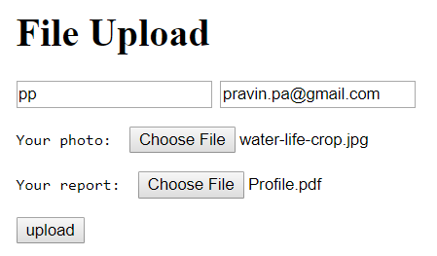
File Uploading

Slide 23
Other input Elements
<input | type="hidden" name="receiver"
<input | value="pwang@cs.kent.edu" />

Slide 24
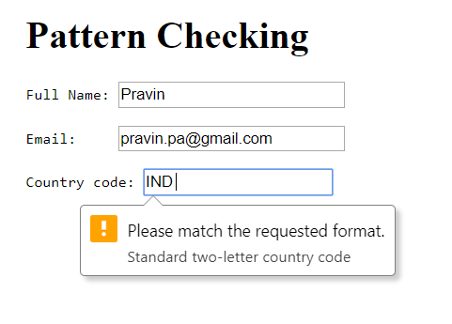
Input Validation Patterns
To check for correct input, you may specify a regular expression pattern:
<label for="c">Country code:</label>
<input type="text" id="c" name="c_code" pattern="[A-z]{2}"
title="Standard two-letter country code" />
Demo: Ex: PatternCheck

Slide 25
Layout and Styling of Forms
Text to explain the form is placed before and outside the form.
A form usually uses a single-column format. Related items, such as first name and last name, can be grouped on the same line.
Entries are labeled consistently, and the label tag is used to bind labels to input controls in the HTML code.
Required and optional entries are clearly indicated.
Client-side input validation is employed, and tooltips indicating required input formats are provided.
Avoid long forms. Group related entries together to divide a long form into smaller, more manageable parts.
Avoid repeatedly asking for the same information.

Slide 26
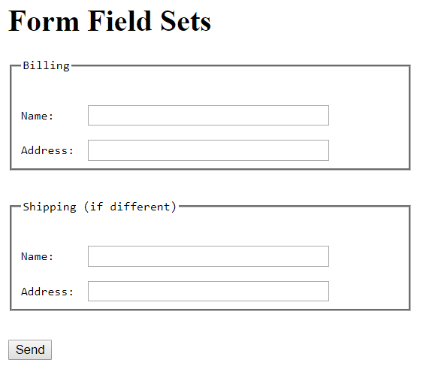
Grouping Form Entries
<fieldset>
<legend>Billing</legend>
...
</fieldset>
<fieldset>
<legend>Shipping (if different)</legend>
...
</fieldset>
Demo: Ex: FieldSet

Slide 27
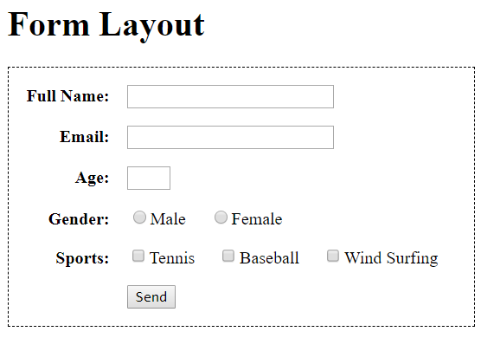
Tabular Form Layout
Forms are often displayed using a table layout to align the labels and input fields in a clear visual grid.
Demo: Ex: FormLayout

Slide 28
Shopping Cart Form
<form method="post" class="shopping">
<table id="cart"><caption><b>Your Cart</b></caption>
<thead><tr><th>Item</th><th>Code</th> <th>Price</th>
<th>Quantity</th> <th>Amount</th></tr></thead>
<tbody><tr>
<th>Hand Shovel</th>
<td class="center" >G10</td> <td>5.99</td>
<td><input type="number" size="4" name="G10_count" value="1" required=""/></td> <td>5.99</td></tr>
<!-- two more rows -->
</tbody></table><p class="buttons">
<input type="submit" name="submit"
value=" Update Cart " formaction="update.php"/>
<input type="submit" name="submit"
value=" Checkout " formaction="checkout.php"/>
</p></form>

Slide 29
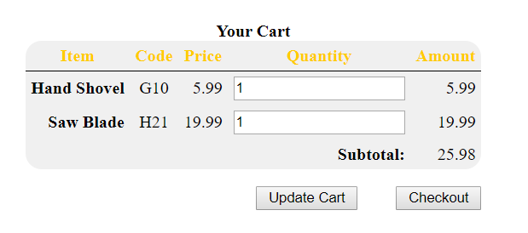
Shopping Cart Form
Demo: Ex: CartForm

Slide 30
Forms and HTTP
Connection—The client opens an HTTP connection to a server specified by the URL.
Query—The client sends an HTTP request to access a resource controlled by the server.
Processing—The server receives and processes the request.
Response—The server sends an HTTP response that can deliver the requested page, results of form processing, or an error message if something is wrong, back to the client.
Transaction finished—The transaction is finished, and the connection between the client and server may be kept open for a follow-up request, or it may be closed.

Slide 31
HTTP Message Format
initial line |  | (different for query and response)
HeaderKey1: | value1 | (zero or more header fields)
HeaderKey2: | value2
HeaderKey3: | value3
 |  | (an empty line separating header and body)
Optional message body contains query or response data. The amount and type of data in the body are specified in the headers.

Slide 32
The Query Line
A query line has three parts separated by spaces: a query method name, a server-side path (URI) of the requested resource, and an HTTP version number.
GET | /path/to/file/index.html | HTTP/1.1
POST | /cgi-bin/script.cgi | HTTP/1.1
HEAD | /path/to/file/index.html | HTTP/1.1
The GET method requests the specified resource and does not allow a message body.
The HEAD query requests only the header part of the response for the requested resource.
The POST method allows a message body consisting of formdata for server-side processing.

Slide 33
The Response Line
HTTP/1.1 | 200 | OK
HTTP/1.1 | 404 | Not Found

Slide 34
The POST Query
Content-Type: application/x-www-form-urlencoded POST /cgi-bin/register-user HTTP/1.1
HOST: www.SymbolicNet.org
From: jDoe@great.enterprise.com
User-Agent: Mozilla/5.0 Gecko/20100101 Firefox/11.0 Content-Type: application/x-www-form-urlencoded Content-Length: 132
name=John+Doe&address=678+Main+Street&...

Slide 35
Formdata Encoding
Formdata, by default, uses the form-urlencoded encoding (media type application/x-www-form-urlencoded).
File uploading uses the multipart/form-data media type.
Certain formdata, such as computer codes, can be sent verbatim without encoding under the text/plain media type.

Slide 36
Formdata Urlencoding
Formdata is form-urlencoded into a string by the following procedure:
The string is in the form of a series of entries separated by &.
Each entry is a name=value pair.
Each space within an entry is replaced by a +.
Unsafe characters in the name and value parts are then encoded. Each unsafe character is replaced by %hh, where hh is its ASCII code in hexadecimal.
Non-ASCII characters are UTF-8 encoded into bytes, and then any unsafe byte is %hh encoded.

Slide 37
Data Posting via GET Queries
As an alternative to the POST query, formdata can be sent via a GET query by appending the form-urlencoded data at the end of the URL locating the server-side program.
In this case, the data sent are known as a query string and are joined to the URL by a ? character:
url of server side program?query string

